Slide 1
MIPS Quality Measures Summary Audit
SETMA Provider Training
October 18, 2016

Slide 2
Overview
Looks for encounters from the previous business day
Groups results by provider name
Looks at two things on each encounter
  MIPS template not accessed at all
  MIPS template accessed but no action taken or measure still out of compliance

Slide 3
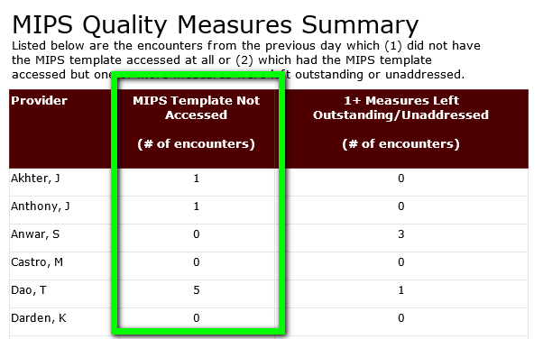
number of Encounters where the MIPS template was not accessed at all

Slide 4
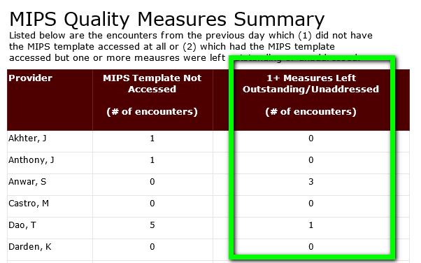
number of Encounters where the MIPS WAS accessed BUT OUTSTANDING MEASURES were not addressed or not brought into compliance

Slide 5
Sometimes there is nothing you can do…BUT IT SERVES AS A REMINDER
Example
Patients with hypertension should have their blood pressure controlled to < 140/90 mmHg.
The measure requires that the patient’s blood pressure be this low throughout the entire reporting period. So, if the patient comes in and their lowest blood pressure for the day is > 140/90 mmHg then they are out of compliance.
In this case the measure will stay in red because the patient’s blood pressure is considered uncontrolled. The red remains to help you remember to pay attention to the blood pressure and attempt to get it into good standing.

